Slide 1

COLORADO MOUNTAIN COLLEGE
SharePoint Online Migration
Business Needs
Colorado Mountain College was looking to move to SharePoint Online from their existing intranet in order to improve communication, collaboration, and content governance both amongst staff and students. The move to SharePoint Online included dropping an overlay tool (Ellucian), allowing the college to reduce licensing costs for that third party software. They also had targeted workflows that they wanted automated to improve operational processes within the college administration and student course requests. Overall, the migration to SharePoint Online was a means of driving modernization across their organization.
What We Did
Affirma performed an assessment of CMC’s business requirements and built and configured the new SharePoint Intranet sites to support and improve their current operational processes. Using modern web parts, the new SharePoint sites integrated social media feeds, announcement notifications, and other modernized communications features. Affima also used the SPFx framework to create custom web parts specific to the college’s business needs, including a piece called MyCMCApps that allows individual users to customize their experience. The implementation of SharePoint Online also involved a lift and shift of site content, which prompted CMC to streamline their repository and eliminate outdated items. The SharePoint sites also provided a platform to house newly automated workflows for administrative functions at the college, which were generated with PowerApps and PowerAutomate in parallel to the migration via the CMC Workflows Development project.
The Results
The client was able to take the next step in moving away from cumbersome and outdated technology (Ellucian) that had been holding back processes and modernization efforts. The implementation of SharePoint Online also allowed CMC to move forward with automation of 6 workflows, improving ease and efficiency within their organization. The new site model improved the ability for CMC to manage sites and govern user permissions. The new CMC BaseCamp intranet also empowers users with easy access to resources and ways to customize their use of the portal.

Slide 2
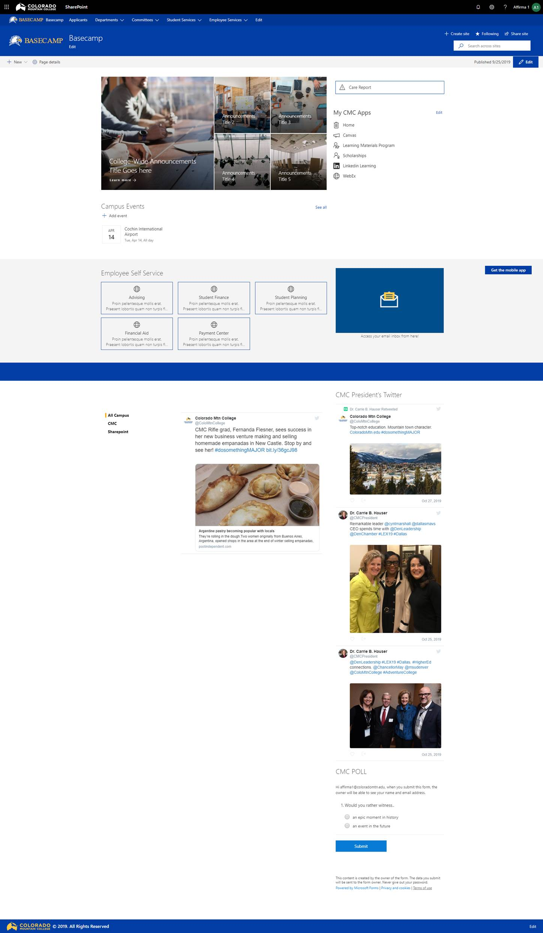
COLORADO MOUNTAIN COLLEGE
SharePoint Online Migration
Business Needs

Slide 3
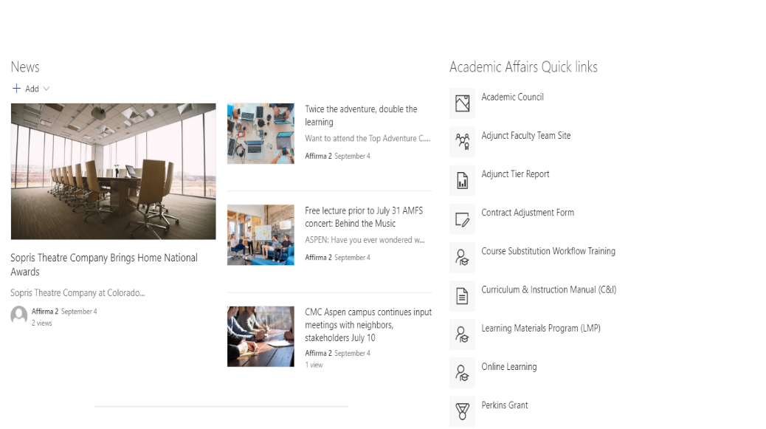
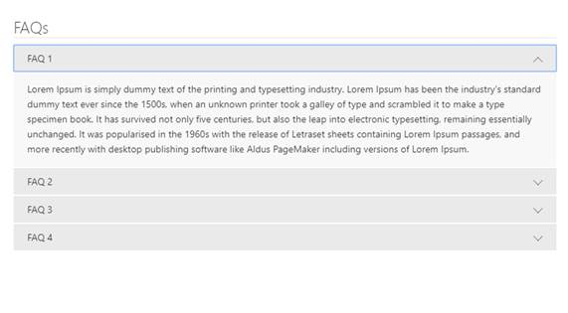
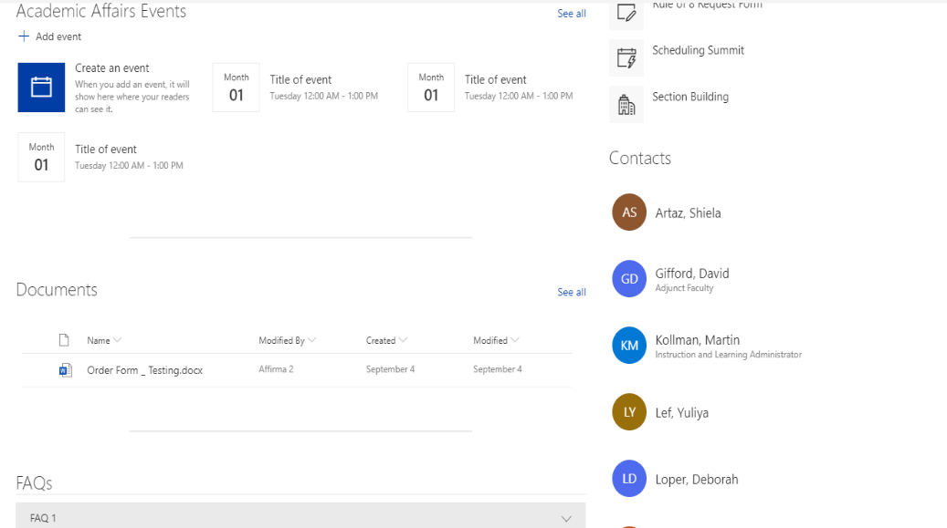
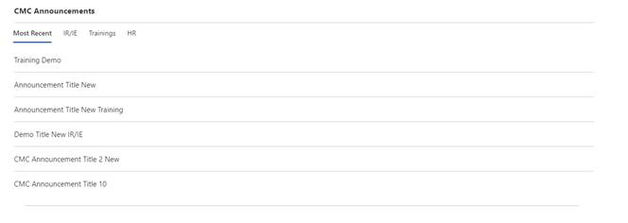
COLORADO MOUNTAIN COLLEGE
SharePoint Online Migration
Standard Dept Collection
Custom FAQ SPFx Web Part
Custom Announcements Web Part

